Slide 1
The Transition into Project Management
Course Introduction

Slide 2
You Are Here
Course Introduction
The Accidental Profession
Project Initiation
Project Planning
Project Execution
Project Control
Project Closeout
Course Conclusion
Notes:
Purpose: Give the students both a view of where they are in the course and where they’re going.
There will be a test at the end of the class.
Key Points: The COURSE has an Introduction and a CONCLUSION. The five main sections follow the five main processes for project management.
Transition: “Now let’s look at COURSE Objectives.”
Cross Reference to Auxiliary Material: PMBOK 2000

Slide 3
Course Objectives
Allow participants to:
  Understand the fundamental principles of project management
  Understand the benefits of good people
  Understand the processes used in project management
  Understand the basic tools for managing small projects
  Be able to summarize senior management’s role in project selection, sponsorship, and direction
  Be able to explain when to ask for help on projects
  This course is not intended to make anyone a project management expert.
Notes:
Purpose: To set the student’s expectations.
Key Points:
This is an INTRODUCTORY class, not an advanced class.
The difference between large & small projects.
We will touch on all KAs and the PLCP but not in detail.
4. Not much on Electronic Tools and you will see why.
Transition: “Let’s take a quick look at the Key Knowledge Areas we’ll be discussing.”
Cross Reference to Auxiliary Material:

Slide 4
Project Management Knowledge Areas and Project Management Processes from PMBOK
Integration Management Project Plan Development Project Plan Execution Overall Change Control | Scope Management Initiation Scope Planning Scope Definition Scope Verification Scope Change Control | Time Management Activity Definition Activity Sequencing Activity Duration Estimating Schedule Development Schedule Control
Cost Management Resource Planning Cost Estimating Cost Budgeting Cost Control | Quality Management Quality Planning Quality Assurance Quality Control | Human Resources Management Organizational Planning Staff Acquisition Team Development
Communications Management Communications Management Information Distribution Performance Reporting Administrative Closure | Risk Management Risk Identification Risk Quantification Risk Response Development Risk Response Control | Procurement Management Procurement Planning Solicitation Planning Solicitation Source Selection Contract Administration Contract Close-out
Notes:
Purpose: To show all of the processes from the PMBOK.
Key Points:
We’ll review each of the Project Management Knowledge Areas separately.
We’ll briefly discuss each of the Project Management Processes.
3. Explain PMI (founded in 1969) and GDITA
Transition: “Now let’s look at the why this course is organized in the way it is.”
Cross Reference to Auxiliary Material: Chart adapted
from PMI’s PMBOK.

Slide 5
Project Life Cycle Processes
Planning
Scope statement
Create a project team
Work breakdown structure (WBS)
WBS directory
Finalize the team
Network diagram
Estimate time and cost
Critical path
Schedule
Budget
Procurement plan
Quality plan
Risk identification, quantification and response development
Change control plan
Communications plan
Management plan
Final project plan
Project plan approval
Kickoff meeting
Execution
Executing the project plan
Complete work packages or tasks
Information distribution
Quality assurance
Team development
Scope verification
Progress meetings
Close-out
Procurement audits
Product verification
Formal acceptance
Lessons learned
Update records
Archive records
Release team
Initiation
Feasibility
High-level planning
Charter
Control
Overall change control
Performance reporting
Scope control
Quality control
Risk response control
Schedule control
Cost control
Manage by exception to the project plan
Overall
Influencing the organization
Leading
Problem solving
Negotiating
Communications
Meetings
*Adapted from the PMI PMBOK
and Rita Mulcahy, PMP Exam Prep
Notes:
Purpose: To show the Project Life Cycle processes. To show why the class is organized in this way.
Key Points:
Our main course modules are based on these Project Life Cycle Processes.
Each will be discussed in reasonable depth except for budgeting, cost controls and negotiating.
3. Mention PMI’s certification PMP and
Certified Associate In Project Management (CAPM)
Transition: “Let’s look at what it means to be a project management professional.”
Cross Reference to Auxiliary Material:

Slide 6
The Transition into Project Management
The Accidental Profession

Slide 7
You Are Here
Course Introduction
The Accidental Profession
Project Initiation
Project Planning
Project Execution
Project Control
Project Closeout
Course Conclusion
Notes:
Purpose: To give the students a view of where they’ve been in the course, where they are in the course and where they’re going in the course.
Key Points:
Project Management has grown into a profession, but many ‘project managers’ still become project managers by accident.
Ask “By a show of hands, who started college or your career with the goal of being a project manager?”
Transition: “Let’s look at the objectives for this module.”
Cross Reference to Auxiliary Material:

Slide 8
Module Objective
Be able to define “project”
Give examples of project and non-project efforts
Describe the motivation for project management
Outline some main principles of project management
Introduce the ACME Case Study
Notes:
Purpose: Set the student’s expectations.
Key Points: Ask students “How important is good project management?” They may be surprised at how many projects fail.
Case study will be cumulative, Exercise 1 is used in exercise 2, etc.
Transition: “First, let’s define what a project is and what it isn’t.”
Cross Reference to Auxiliary Material:

Slide 9
What is a Project?
A temporary endeavor to create a unique product or service. (PMBOK 2000*)
How does this differ from a task?
How does this differ from a ‘to do’ list?
*The Project Management Institute, http://www.pmi.org/
Notes:
Purpose: Ensure students understand what is and what isn’t a project.
Key Points:
Projects and operations are
performed by people
constrained by limited resources
planned, executed and controlled
A project differs in the complexity and risk from a task or a ‘to do’ list.
The difference between unique vs. enhancement.
Identify the PMBOK 2000 as the Project Management Body of Knowledge from the Project Management Institute. Note the url.
Transition: “Let’s look at some examples of projects and non-projects.”
Cross Reference to Auxiliary Material: PMBOK 2000

Slide 10
Example of Project/Nonprojects
Projects | Nonprojects
Setting up a new network | Maintaining an established network
Throwing a big party | Reading email every morning
Driving to New York for vacation | Driving to work everyday
Raising capital funds for a church | Holding a status meeting
Notes:
Purpose: Ensure students understand what is and what isn’t a project.
Key Points:
Discuss why each of the items is or isn’t a project. Allow for some ‘interpretation’ that may change the classification.
Ask “What are some of the projects and non-projects that you’re familiar with?”
Transition: “Now that we know what a PROJECT is, let’s look at what MANAGEMENT is.”
Cross Reference to Auxiliary Material:

Slide 11
What is Management?
What do managers do? (Besides drink coffee)
How do they get it done?
What kind of knowledge and skills do managers need?
Notes:
Purpose: Ensure students understand what a manager is and what a manager does.
Key Points:
Managers initiate, control, plan and guide execution, among other things. It’s important to get the students to understand the functions of a manager.
Managers work with people, usually. “Management is a contact sport.” Managers use processes to help them work with people.
Most importantly, managers must know how to deal with people. In some fields they also need some of the ‘hard’ skills.
Transition: “Now that we know what a PROJECT is and what MANAGEMENT is, let’s look at what PROJECT MANAGEMENT is.”
Cross Reference to Auxiliary Material:

Slide 12
What is Project Management?
The application of knowledge, skills, tools and techniques to project activities to meet the project requirements
Accomplished through the use of the many processes including initiating, planning, executing, controlling and closing
Accomplished through the application of many key knowledge areas including integration management, cost management, communication management, scope management, quality management, risk management, time management, human resources management and procurement management
Notes:
Purpose: To ensure that the students understand what it means to MANAGE a PROJECT.
Key Points:
There are 5 major processes in project management; these are divided into additional processes.
There are 9 key knowledge areas in project management.
Transition: “How many IT projects fail? How many are challenged? How many succeed?”
Cross Reference to Auxiliary Material: PMBOK 2000

Slide 13
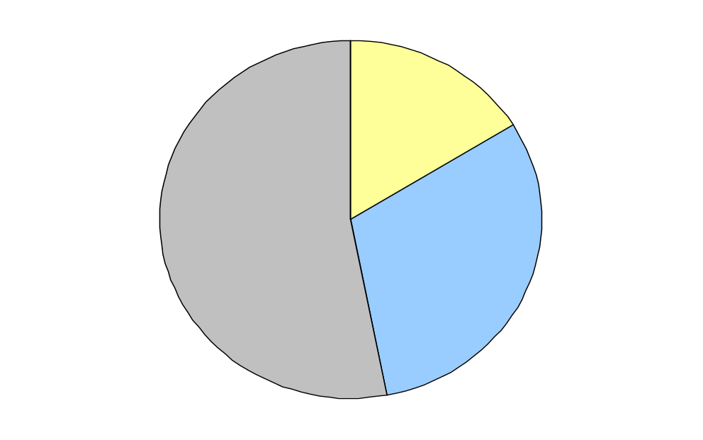
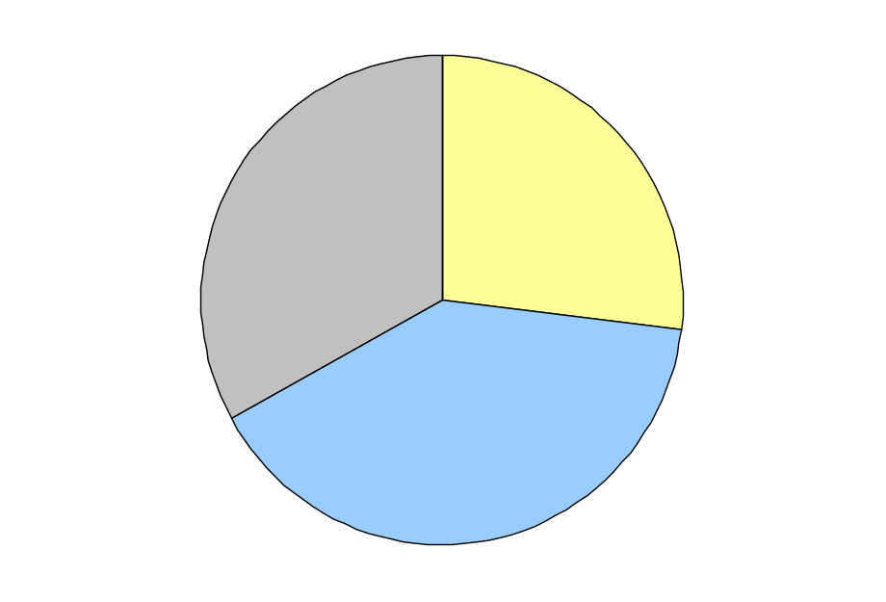
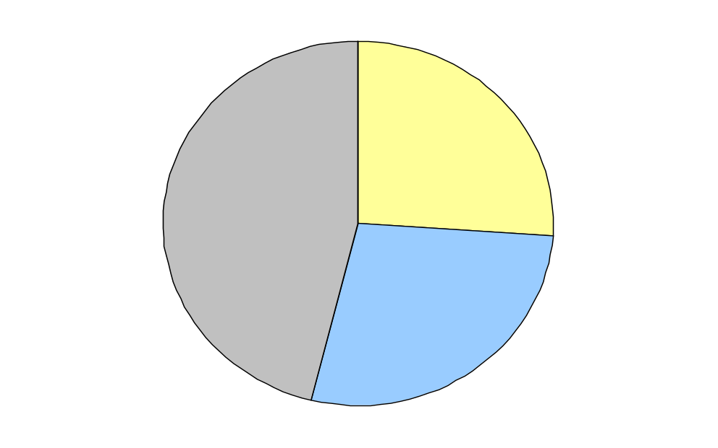
The Need for IT Project Management*
What does it cost? In 1996 $45B in cost overruns, $100B in failed projects
1994 Project
Success Rates
1996 Project
Success Rates
1998 Project
Success Rates
Succeed
16%
Succeed
26%
Challenged
33%
Succeed
27%
Challenged
53%
Challenged
46%
Failed
31%
Failed
28%
Failed
40%
*Data from http://www./standishgroup.com/_compass/chaos99.htm
Notes:
Purpose: To show students that IT Project Management is often done poorly, but that with good Project Management success rates are much, much higher.
THERE IS AN EXCELLENT OPPORTUNITY TO DRAMATICALLY IMPROVE THE RESULTS ACHIEVED BY IMPORTANT PROJECTS.
Key Notes:
Many IT projects fail.
Larger projects fail more often than smaller ones.
Good project management practices can dramatically improve the chance of success.
Transition: “Let’s see how size affects success.”
Cross Reference to Auxiliary Material: Standish Group Chaos Report

Slide 14
1998 Success Rates versus Project Costs
60%
55%
50%
% of Projects Succeeding
40%
33%
30%
25%
20%
15%
8%
10%
0%
0%
<$750K
> $10M
Project Costs
$1.5M - $3M
$3M - $6M
$6M - $10M
$750K - $1,500K
Table adapted from Chaos Report, Standish Group, 1999.
Notes:
Purpose: To show students that, as the size of the IT project increase, the chance of the project succeeding diminishes.
Key Points:
IT Projects become geometrically complex as they get bigger. This isn’t true in some other types of projects.
Idiots don’t management large IT projects, but projects still often fail.
Good project managers seldom fail.
Transition: “Let’s see what a survey by the Standish Group says about the factors for IT project success.”
Cross Reference to Auxiliary Material:
The Chaos Report, Standish Group, 1999

Slide 15
The CHAOS* Ten Success Factors
  User Involvement 20 Points
  Executive Support 15 Points
  Clear Business Objectives 15 Points
  Firm Basic Requirements 10 Points
  Competent Staff 10 Points
  Small Milestones 10 Points
  Experienced Project Manager 5 Points
  Proper Planning 5 Points
  Ownership 5 Points
  Other 5 Points
*Data from http://www./standishgroup.com/_compass/chaos97.htm
Notes:
Purpose: To point out to students that many people believe that project success has a great deal to do with the SOFT areas of Project Management.
Key Points:
User involvement does appear to be the most critical success factor.
Executive support is also critically important.
Clear business objectives are also one of the top three critical factors.
Ask for perspectives from the student’s own experience.
Transition: “Lets look at what constrains projects.”
Cross Reference to Auxiliary Material:
http://www./standishgroup.com/_compass/chaos97.htm

Slide 16
The Triple Constraints
Project
Time
Cost
Quality
Notes:
Purpose: To describe the triple constraints of project management. To show how these constraints are DEPENDENT.
Key Points:
Each of the three classic constraints, cost, quality and time, are equally important for holding up the three-legged stool.
No one is more important than the other.
Transition: “Now lets look at the factors involved in productivity in IT projects.”
Cross Reference to Auxiliary Material: PMBOK 2000

Slide 17
Productivity - The Three Legs
People
Processes
Tools
Notes:
Purpose: To introduce the concept of productivity and the project manager’s role in productivity.
Key Points:
People, processes and tools are the three legs of productivity, in that order.
Managing each of these areas is important to good IT project management.
There are different measures for productivity, but SLOC/Staff Month for a person or SLOC/Calendar Month for an organization are common examples.
Transition: “Let’s look at the importance of each of these three factors.”
Cross Reference to Auxiliary Material:
Rise and Resurrection of the American Programmer, 1996, Edward Yourdon

Slide 18
The Advantages of Good People*
“Good tools typically increase productivity by 25%-35% and good processes can increase productivity by 50%-100%; but the best people are typically 10-20 times more productive than the average, and as much as 100-200 times better than the worst.”
*Analysis from “The Yourdon Analysis,” August 1995, Edward Yourdon, Compuserve: 71520,2322, Yourdon@acm.org
Notes:
Purpose: To show the typical increases in productivity for people, processes and tools.
Key Points:
People, typically, have the greatest impact on productivity.
In large scale IT projects, good processes and tools are also critical.
Transition: “Again, the most important factor in productivity is people. Let’s take a closer look at what a project manager can do to improve the productivity of people.”
Cross Reference to Auxiliary Material:
“The Yourdon Analysis,” August 1995, Edward Yourdon, Compuserve: 71520,2322, Yourdon@acm.org

Slide 19
The Advantages of Good People*
The best performer is over 16 times more productive than the worst; performers in the 4th quintile are 2 times more productive than those in the 3rd.
Average
Performers
(40%)
Worst
Performers
(5%)
Below Average
Performers
(25%)
Above Average
Performers
(25%)
Best
Performers
(5%)
# of
people
5 10 15 20 25 30 35 40 45 50 55 60 65 70 75 80 85 90 95
*Data from TECKCHEK, INC; http://www.teckchek.com
Proficiency Score
Notes:
Purpose: To demonstrate that you can test people for fundamental skills.
Key Points:
Knowledge is necessary to be productive.
In C programming it’s necessary to test for vocabulary, syntax and grammar, much like testing a writer.
Explain the Teckchek testing procedure.
Past productivity predicts future productivity. Put the most skilled people on the most difficult tasks.
Less skilled people are more error prone.
Transition: “Well, what about good process?”
Cross Reference to Auxiliary Material: TECKCHEK, INC.

Slide 20
The Advantage of Good Processes
Value of Process Improvement
  An organization can expect after three years effort in process improvement using a documented process
    A return on investment of approximately 7:1
    A gain per year in productivity of approximately 35%
    More defects found in pretest (for software approximately 20%)
    A reduction in time to market of approximately 20%
    A reduction in field errors reported per year (for software approximately 45%)
Notes:
Purpose: To demonstrate the improvements that good processes can bring.
Key Points:
Note that the returns can compound over time.
Ask “what would these types of improvements mean to your organizations?”
Ask “what types of improvements might you expect to see in your organizations?
Transition: “If it’s obvious that good processes are
important, what percent of organizations are level 1
in the Capability Maturity Model?”
Cross Reference to Auxiliary Material:

Slide 21
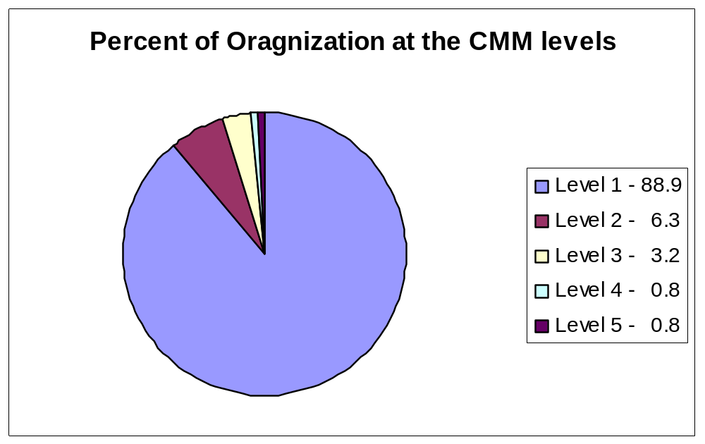
CMM - Good Processes
From PMI Center for Business Practices
Notes:
Purpose: To demonstrate that there is incredible
opportunity for process improvement in our
industry.
Key Points:
Note that the majority are ad hoc and unproductive..
Ask “what does this mean for your organizations?”
Transition: “Well, what about good tools?”
Cross Reference to Auxiliary Material:

Slide 22
The Advantage of Good Tools
Good tools are designed to
  Simplify the essence of IT project management
  Reduce the understanding required of how the details relate to each other -- effective communications
Essential tools include
  General office (e.g., Word, Excel, Powerpoint)
  Project Management (e.g., Microsoft Project)
  Requirements definition (e.g., RequisitePro)
  Requirements management (e.g., ClearQuest)
  Design Definition (e.g., Rational Rose)
  Configuration Management and Problem Tracking
  (e.g., ClearCase)
  Top Down Estimation (e.g., SLIM)
Notes:
Purpose: To help student recognize that good tools are necessary, but insufficient to ensure a successful project.
Key Points:
Tools in IT projects are to help simplify the details
Critical tools for software development include tools for requirements definition, requirements management, configuration management and change control.
For large software development projects an historical-based estimating tool is critical.
Transition: “Let’s look at some fundamental principles of IT Project Management.”
Cross Reference to Auxiliary Material:

Slide 23
The Fundamental Principles of IT Project Management
As Project Size Increases:
  The types of effort change with much more management and paperwork needed
  The number of potential defects increases
  IT System complexity increases
  Organizational complexity increases
The Productivity of an organization decreases as project size increases, unless the people, process and tool opportunities are realized.
Notes:
Purpose: To ensure that the students understand that complexity increases as the size of an IT project increases.
Key Points:
It’s important to keep the staff as small as possible, often by using only the very best people.
It’s important to keep the size of the project under control. SCOPE CREEP is the death of many projects. Ask “What is Scope Creep?”
There are opportunities to improve productivity.
Ask “what opportunities have you seen in your projects?”
Transition: “Communication is critically important to productivity. Let’s look at this knowledge area.”
Cross Reference to Auxiliary Material:

Slide 24
Key Knowledge Area – Communications Management
Communications Planning
  Stakeholder Analysis
  Constraints
Information Distribution
  Frequency
  Method
Cost of Communications (n*(n-1))/2
  For a project of 30 people, the communications overhead will normally be almost 50% (Software Project Dynamics: An Integrated Approach by Adbel-Hamid and Madnick)
Notes:
Purpose: To reinforce the importance of communications as a key knowledge area.
Key Points:
Often 90% of a project managers time is communicating.
Using the (n*n-1)/2 formula, show that there are 10 bilateral lines of communications in a 5 person organization, but 190 in a 20 person organization. If each bilateral line of communications is exercised for 1 hour per day; in the 5 person organization, this would take 2 hours/day (10 lines/5 people); the same level of communications in a 20 person organization would take 9.5 hours/day (190 lines/20 people).
Transition: “Now let’s apply some learning.”
Cross Reference to Auxiliary Material: Software Project Dynamics: An Integrated Approach, Abdel-Hamid and Madnick

Slide 25
Case Study – You Are Here
Introduction to ACME Case Study
  Objectives:
  Learn, Reinforce, Build Team Skills, Fun
Getting Started Exercise
Project Initiation and Risk Exercise
Project Planning Exercise
Project Execution Exercise
Project Control Exercise
Notes:
Purpose: Introduction of the ACME Case Study Objectives
Key Points:
Objective is to Learn by Doing
Objective is to Reinforce the Lecture Material
Objective is to Build Team Skills (Work as a team to develop your solutions)
Objective is to Have Fun (Challenging but Fun)
Transition: “Lets move into the first exercise’”
Cross Reference to Auxiliary Material: ACME Case Study

Slide 26
Case Study – You Are Here
Introduction to ACME Case Study
Getting Started Exercise
  Read Project Background
  Stakeholders and Needs Assessment
  Communications Planning
Project Initiation and Risk Exercise
Project Planning Exercise
Project Execution Exercise
Project Control Exercise
Notes:
Purpose: All students to understand where they are in relationship to all the Case Study exercises
Key Points:
We’ll break into small groups.
The first thing that’s needed is to identify stakeholders and to identify communications needs.
Ask why communications needs are so important.
Transition: “Lets get started reading the material and answering the questions in the exercise…help is available.”
See Case Study Instructor Notes for Further Details
Cross Reference to Auxiliary Material: ACME Case Study

Slide 27
The ACME Case Study
Break into four groups of four
Review the ACME Case Study materials (page 3)
Identify the stakeholders
Identify the information needs of the stakeholders (page 4)
Begin Communications planning (page 6)
Notes:
Purpose: To introduce the ACME Case Study and to begin the process of completing it.
Key Points:
Ask “What is a stakeholder, a customer?”
Stakeholder is any person or group positively or negatively affected by the project outcome.
These groups will stay together for the 2 days of the class.
Finish the work in 30 minutes.
Transition: “When we finish with the exercise, the facilitator will debrief the four groups of four. Then we’ll get back together to discuss the ‘Project Initiation Process.’”
Cross Reference to Auxiliary Material: ACME Case Study

Slide 28
The ACME Case Study
Stay in your teams
Review the stakeholders as handed out
Identify the information needs of the stakeholders Begin Communications planning (page 7)
Notes:
Purpose: To introduce the ACME Case Study and to begin the process of completing it.
Key Points:
Cross Reference to Auxiliary Material: ACME Case Study

Slide 29
The Transition into Project Management
Project Initiation

Slide 30
You Are Here
Course Introduction
The Accidental Profession
Project Initiation
Project Planning
Project Execution
Project Control
Project Closeout
Course Conclusion
Notes:
Purpose: To give the students a view of where they’ve been in the course, where they are in the course and where they’re going in the course.
Key Points:
1. This is the first of the five major Project Life Cycle Management Processes defined by the PMBOK.
2. A good start is critical to success.
Transition: “Let’s look at the objectives for this module.”
Cross Reference to Auxiliary Material:

Slide 31
Module Objectives
Allow participants to:
  Understand Scope Management
  Understand Risk Management
  Be able to develop a Project Charter
Notes:
Purpose: To set student expectations.
Key Points:
In this section we’ll study two key knowledge areas.
Projects have a much better chance of success when the project manager is involved early on.
This is one of the harder modules, pay close attention.
Transition: “Let’s look at Scope Management.”
Cross Reference to Auxiliary Material:

Slide 32
What is Scope Management?
Managing what IS and what IS NOT included in the project.
What is Scope Creep?
Product/Service Scope – features and functions
Project Scope – the work necessary to deliver the features and functions
Notes:
Purpose: To introduce the Key Knowledge Area of Scope Management.
Key Points:
Give some examples of “Scope Creep” in your own projects.
Ask “What is ‘Gold Plating?’’”
Transition: “Now let’s look at some of the processes used in Scope Management.”
Cross Reference to Auxiliary Material:

Slide 33
Processes in Scope Management
Initiation – authorizing the project or phase to begin
Scope Planning – developing a written scope statement
Scope Definition – subdividing the major project deliverables
Scope Verification – formalizing acceptance of the project scope
Scope Change Management – controlling changes to project scope
Notes:
Purpose: To introduce the students to the processes involved in Scope Management.
Key Points:
These six process are some of the most important in project management. Again, it ensures that we’re doing the right thing.
Talk about each process separately and ask for questions.
Transition: “One issue of Scope Management is whether or not we have gathered the right requirements from the customer.”
Cross Reference to Auxiliary Material:

Slide 34
Importance of Customer Oriented Requirements Gathering Practices
Gathered
Require-
ments
Real
Require-
ments
Gathered
Require-
ments
Real
Require-
ments
Without Customer Oriented
Requirements - Gathering
Practices
With Customer Oriented
Requirements - Gathering
Practices
*Graph from Rapid Development, Taming Wild Software Schedules.
Steve McConnell
Notes:
Purpose: To illustrate that the wrong product or service could still be built, even if they closely matched the gathered requirements.
Key Points:
If customers ‘don’t have time’ to participate in a requirements workshop, the project probably isn’t very important.
If customers ‘don’t have time’ to participate in a requirements workshop, the project will probably fail.
Transition: “Now let’s discuss the next Key Knowledge Area, Risk Management.”
Cross Reference to Auxiliary Material: Rapid Development, Taming Wild Software Schedules, Steve McConnell

Slide 35
What is Project Risk Management?
The systematic process of identifying, analyzing and responding to project risks.
What is a risk?
What is a mistake?
Why is Project Risk Management important?
  Foresight is an excellent management quality – anticipate problems
  Prevention versus Correction -
    Prevention is less costly
Notes:
Purpose: To ensure the students know what a risk is and why risk management is important.
Key Points:
A risk is the probability that something bad will happen. Also, the uncertainty surrounding a desired outcome.
A mistake is the certainty that something bad will happen.
It is a mistake to take an action which will certainly result in bad things happening.
Transition: “Let’s look at one way to classify risks.”
Cross Reference to Auxiliary Material:

Slide 36
Classification of Risks
Known - One that has been experienced before or is anticipated.
Unknown - One that has not been experienced before but could be discovered if looked for.
Unknowable - One that is not possible to understand or is too costly to uncover.
Negative (Threats)
Positive (Opportunities)
Notes:
Purpose: To give the student a better understanding of risk classification. A better vocabulary should help to better thinking about risks.
Key Points:
Contingency Plans can be used to help manage unknown and unknowable risks.
Some things that are unknown or unknowable may actually help a project.
Transition: “Let’s talk a little more about Contingency Planning.”
Cross Reference to Auxiliary Material:

Slide 37
Contingency Planning
What is a contingency plan?
What is a workaround?
Why is contingency planning important?
Why are workarounds important?
  Usually involves problem solving
Why is probability (of a problem occurring) X cost (should a risk occur) important?
Notes:
Purpose: To help the student understand how to plan contingencies.
Key Points:
Contingency plans are executed as a response to an anticipated risk event. Not all risk events will have contingency plans developed.
Workarounds are executed as a response to an unanticipated risk event.
Probability x Cost is the “Value” of the risk. That is, it allows a project manager to look at multiple risks in terms of “Value” rather than just probability. “A small risk with a terrible consequence is still very important.”
Transition: “Now let’s see how uncertainty changes over the life-cycle of a project.”
Cross Reference to Auxiliary Material:

Slide 38
Levels of Uncertainty by Phase
100%
75%
50%
Size
Estimate
Growth
(in lines
of source
code)
25%
0%
-25%
-50%
-75%
-100%
Initial product
definition
Requirements
development
Detailed
design
Approved product
definition
Architecture
Product Complete
Software Project Survival Guide, Steve McConnell
http://www.construx.com
Notes:
Purpose: To show that uncertainty diminishes over the life-cycle of the project.
Key Points:
Note that many uncertainties decreases by phase in a project.
Normally, the expected values for outcomes do use up the contingency.
Transition: “Let’s look at some ways of looking at and thinking about risks.”
Cross Reference to Auxiliary Material:
Software Project Survival Guide, Steve McConnell

Slide 39
Ways of Looking at Risks
Philosophy
  Be an ostrich: Ignore risk and do nothing.
  Be reckless: Ignore risk and crash on regardless.
  Be professional: Take calculated risks. Accept risk and live with it (Implies knowledge and understanding of the risks).
  Be an astronaut: Eliminate all risks (not usually cost effective in business systems and often not possible).
Notes:
Purpose: To show students that a choice in how to look at risks needs to be made.
Key Points:
For IT projects, somewhere between 5% and 10% of the project spending should be spent in risk management. Normally, less than .5% is actually spent, but this leads to many problems and is not optimal.
All risks can’t reasonably be eliminated.
Transition: “How can you assess the maturity of an organization in the approach to Risk Management?”
Cross Reference to Auxiliary Material:

Slide 40
Level of Maturity of Risk Management
  Crisis management
  Fix on failure
  Risk mitigation
  Prevention
  Elimination of root causes
  Aim to operate at 4/5
Notes:
Cross Reference to Auxiliary Material:
Rapid Development, Steve McConnell
Purpose: To show that a Risk Management maturity level can be assessed for an organization.
Key Points:
Crisis management is fire fighting. It’s necessary, but fire prevention is more effective in the long run.
Don’t ignore fires.
Transition: “Let’s look at the 4 processes in Risk Management.”

Slide 41
Processes in Risk Management
Risk Identification
Risk Quantification
Risk Response Development
Risk Response Control
Notes:
Purpose: To introduce the students to the four Risk Management processes.
Key Points:
In a project most risks are known by someone, but they are reluctant to discuss them.
It’s cheaper and easier to foresee risks.
Transition: “Let’s summarize some important points about Risk Management.”
Cross Reference to Auxiliary Material:

Slide 42
Project Risk Management Summary
Recognize mistakes and avoid them
Identify as many risks as possible
Manage and report them continuously
Provide some contingency for the unknowable risks
One of the most important parts of team communications is identifying changes to risks!
Notes:
Purpose: To reinforce the learning about Risk Management.
Key Points:
One classification for risks is by their impact, for example, schedule risks, cost risks, resource risks or quality risks.
Mistakes should be avoided.
Transition: Ask “What is a Project Charter?”
Cross Reference to Auxiliary Material:
*CMU, SEI Systems Engineering CMM, Version 1.1

Slide 43
What is a Project Charter?
A formal document that briefly describes
  Project Goals and Objectives
  The Desired Product/Service
  What is and what IS NOT in the Scope of the Project
  Risks
  Project Success Factors
Gives AUTHORITY to the Project Manager
Notes:
Purpose: To introduce the concept of a project charter.
Key Points:
The project charter should include what’s being done and why. This is sometimes all included in a “proposal,” which can replace a charter for small projects.
The Project Success Factors are the main “QUALITY” objectives of the project. That’s the big Q quality.
The Project Charter should be signed off.
Project Charters have some additional content in different organizations.
Ask “Why is all this important?” Emphasize Scope Creep and Communications.
Transition: “Now let’s apply some of this learning.”
Cross Reference to Auxiliary Material:

Slide 44
Case Study – You Are Here
Introduction to ACME Case Study
Getting Started Exercise
Project Initiation and Risk Exercise
  Risk Assessment Survey
  Project Charter
Project Planning Exercise
Project Execution Exercise
Project Control Exercise
Notes:
Purpose: Allow students to see where they are relative to all Case Study exercises
Key Points:
We’ll be braking into groups to do a Risk Exercise and a Project Charter Exercise.
The risk identification questionnaire is common in most IT projects.
The risk identification questionnaire is used many times during the life of a project.
Transition: “Lets get started reading the material and answering the questions in the exercise… instructors will be available to offer help.”
See Case Study Instructor Notes for Further Details
Cross Reference to Auxiliary Material: ACME Case Study

Slide 45
The ACME Case Study
Break into four groups of four
Review the ACME Case Study materials (page 9)
Fill out a Risk Assessment Survey (pages 10 and 11)
Assume the project is in the INITIATION phase, some questions won’t apply
Notes:
Purpose: To reinforce the lessons of the module.
Key Points:
Break into the same groups of four.
Fill out the Risk Assessment Survey
Complete the Stakeholder/Project Scope template
Spend 15-30 minutes.
Transition: “After this exercise we’ll do a project charter exercise.”
Cross Reference to Auxiliary Material: ACME Case Study Materials

Slide 46
The ACME Case Study
Stay in your groups
Create a project charter
  Review page 14 and fill in table at the bottom
  Complete the project charter
  (pages 16, 17 and 18)
Notes:
Purpose: To reinforce the lessons of the module.
Key Points:
Stay in the same groups of four.
Complete the Stakeholder/Project Scope template
Use the Project Charter templates that have been provided.
Spend 15-45 minutes on the exercise.
Transition: “After this exercise we’ll start studying the Project Planning Process.”
Cross Reference to Auxiliary Material: ACME Case Study Materials

Slide 47
The Transition into Project Management
Project Planning

Slide 48
You Are Here
Course Introduction
The Accidental Profession
Project Initiation
Project Planning
Project Execution
Project Control
Project Closeout
Course Conclusion
Notes:
Purpose: To give the students a view of where they’ve been in the course, where they are in the course and where they’re going in the course.
Key Points:
We now know what it is we’re trying to do from Project Initiation.
We need to know how to create a good project plan appropriate for the amount of work to be done and the complexity of the work.
Transition: “Let’s look at the module objectives.”
Cross Reference to Auxiliary Material:

Slide 49
Module Objectives
Allow participants to:
  Understand Integration Management, Quality Management and Time Management
  Build a Work Breakdown Structure (WBS)
  Estimate Resources, Time, and Effort
  Develop a Critical Path
  Describe a Complete Project Plan
Notes:
Purpose: To set student expectations.
Key Points:
This module teaches 4 Key Knowledge Areas: Integration, Cost, Quality and Time Management.
This module also discusses the difficulties of estimating.
Finally, we get into some real planning.
Transition: “Let’s first look at how much time and effort should be spent on planning and when it should be spent.”
Cross Reference to Auxiliary Material:

Slide 50
Rolling Wave Planning
Bar thickness indicates relative staffing levels
Good
Plan over time
Plan
Upfront
Only
The degree of detail in the planning at any point should
be sufficient to allow good prediction and control
  Most tasks should be planned at least one month out in detail
  Critical path tasks should be planned at least two
  month’s out in detail
Bad
Plan in detail the next phase and at a summary level for
later phases
Expand the Detailed Planning window as more information
is known
TIME
Notes:
Purpose: To discuss the Rolling Wave planning concept for large projects in particular.
Key Points:
If too much time is spent up front on detailed planning, the rework time spent on planning will be out of proportion with the rest of the project activities.
If too little time is spent up front on detailed planning, the project can’t be controlled.
Transition:
Cross Reference to Auxiliary Material:

Slide 51
Key Knowledge Area – Integration Management
What is Integration Management?
  Ensuring that the various elements of the project are properly coordinated
  Making tradeoffs among competing objectives and alternatives
  Ensuring that stakeholder needs and expectations are met or exceeded
  Managing the interfaces between key processes
Notes:
Purpose: To introduce the students to the concepts of Project Integration Management.
Key Points:
Integration Management is mostly concerned with ensuring that when it all comes together, the project meets objectives.
Sometimes people become so wrapped up in the details of the project, looking at the totality of the project is ignored.
Transition: “Now let’s look at the processes in Project Integration Management.”
Cross Reference to Auxiliary Material:

Slide 52
Processes in Project Integration Management
Project Plan Development – taking the results of other planning processes and putting them into a consistent, coherent document
Project Plan Execution – carrying out the project plan by performing the activities
Overall Change Control – coordinating changes across the entire project
Notes:
Purpose: To introduce the students to the 3 processes described in the PMBOK for Project Integration Management.
Key Points:
The goal is to have an Integrated Project Plan, this takes a number of steps to achieve.
We’ll be talking about Change Control a lot in this class. It must be done well to have a successful project.
Transition: “Are there any questions about Project Integration Management before we start talking about Project Cost Management?”
Cross Reference to Auxiliary Material:

Slide 53
Key Knowledge Area –
Cost Management
What is Cost Management?
  Ensuring that the project is completed within the approved budget
  Usually primarily concerned with the cost of resources needed to complete project activities
  Should consider the effect of project decisions on the cost of using the project’s targeted product or service
Notes:
Purpose: To introduce the students to the Key Knowledge Area of Project Cost Management.
Key Points:
The broader view of project cost management is often called life-cycle costing. These costs go on beyond the release of a product or service. Ask “Do any of you worry about life-cycle costs?”
Costs frequently need to be managed at the task level, much like schedule.
Transition: “Let’s look at the processes in Project Quality Management.”
Cross Reference to Auxiliary Material:

Slide 54
Key Knowledge Area –
Project Quality Management
What is Quality Management?
  Ensuring that the project will satisfy the needs for which it was undertaken
  It includes all activities of the overall management functions
  Must address both the management of the project and the targeted product or service of the project
Notes:
Purpose: To introduce the students to the Key Knowledge Area of Project Quality Management.
Key Points:
Quality, in this context, is not just “defect free.”
Project Quality Management should ensure that the final product or service, that is the goal of the project, has excellent quality.
Transition: “Let’s look at the processes involved in Project Quality Management.”
Cross Reference to Auxiliary Material:

Slide 55
Processes in Project Quality Management
Quality Planning – identifying which quality standards are relevant to the project and determining how to satisfy them
Quality Assurance – evaluating overall project performance on a regular basis
Quality Control – monitoring specific project results to determine if they comply with relevant quality standards and identifying ways to eliminate causes of unsatisfactory performance
Notes:
Purpose: To introduce the students to the 3 processes described in the PMBOK for Project Quality Management.
Key Points:
Quality Planning takes specific effort, it doesn’t happen naturally in most projects.
There is a complete body of knowledge supported by the American Society for Quality, http://www.asq.org.
Transition: “Although Project Quality Management focuses on meeting project goals, let’s look at the cost of finding and fixing defects in an IT project.”
Cross Reference to Auxiliary Material:

Slide 56
The Impact of Defect Correction
Cost to
Correct
Deferring focus on defect detection until later, when costs of correction will be higher, is not a rational decision.
Phase That a
Defect Is Created
Requirements
Architecture
Detailed design
Construction
Requirements
Architecture
Detailed
design
Construction
Maintenance
Phase That a Defect Is Corrected
Increase in defect cost as time between defect creation and defect correction increases. Effective projects practice “phase containment” —the detection and correction of defects in the same phase in which they are created.
From The Software Project Survival Guide, Steve McConnell.
Notes:
Purpose: To illustrate the impact defect correction has on schedule and cost.
Key Points:
The later defects are detected, the greater the cost.
The later defects are corrected, the greater the cost.
Average costs in the USA for software development is that a defect costs approximately $250 before Unit Tests are complete and approximately $1250 after Unit Tests are complete (and at least $6,000 after Pilots start). (Notes for ASQ seminar, supported by Capers Jones.)
Transition: “Since this isn’t a class on Quality, we won’t dwell on this Key Knowledge Area, but move on to Project Time Management.”
Cross Reference to Auxiliary Material:

Slide 57
Key Knowledge Area –
Project Time Management
What is Project Time Management?
  Ensuring timely completion of the project
  Involves being appropriately efficient and effective with the use of time
Notes:
Purpose: To introduce the students to the Key Knowledge Area of Project Time Management.
Key Points:
Time management is the activity most closely associated with Project Management.
The professional project manager knows when to be efficient and when to be effective.
Transition: “Let’s look at the process involved in Project Time Management.”
Cross Reference to Auxiliary Material:

Slide 58
Processes in Project Time Management
Activity Definition
Activity Sequencing – identifying dependencies
Activity Duration Estimating
Schedule Development – analyzing activity sequences, activity durations, and resource requirements
Schedule Control – controlling changes
Notes:
Purpose: To introduce the students to the 5 processes described in the PMBOK for Project Time Management.
Key Points:
Defining all of the necessary activities is only the beginning.
Dependencies are often overlooked and lead to schedule slips.
We’ll give special emphasis on Duration Estimating.
Ask “What might cause a schedule to change and what can be done to manage change?”
Transition: “The next slide helps to illustrate a process for accurate estimating.”
Cross Reference to Auxiliary Material:

Slide 59
Estimating Accurately
Wideband Delphi: Using Experienced Subject Matter Experts
Examine Requirements
Discuss in the Group
Estimate Anonymously
Calculate Mean and Compare
Discuss Differences
NO
Loop Until
Convergence
Consensus?
YES
Notes:
Purpose: To illustrate a process for accurate estimating.
Key Points:
You can use this method for estimating effort, duration and SIZE.
Find 4 experienced subject matter experts, ask them to estimate anonymously. Ask each expert to estimate best case, most likely case, and worst case. Take a average of the four for the “average” estimates. Then take the “best” best case, the “worst” worst case and calculate the “weighted average” ((worst case+best case+4(average))/6).
Significant differences usually means that the task isn’t well defined.
Transition: “What about top down and bottom up estimations, which is best?”

Slide 60
When to Use Top-Down and Bottom-Up Activity Duration Estimation
Condition / Constraint | Top-Down (Macro) | Bottom-Up (Micro)
Strategic Decision Making | X
Cost & Time Have Priority |  | X
High Uncertainty | X
Internal, Small Project | X
Fixed Price Contract | X* | X*
Customer Wants Detail |  | X
Unstable Scope | X
Why Use Both? Customer or Vendor?
Adapted from Clifford Gray and Erik Larsen’s Project Management
Notes:
Purpose: To show some guidelines for TD vs. BU.
Key Points:
There may be circumstances which cause these guidelines to vary.
Different people will want different Estimations.
Transition: “Let’s take a little quiz to see how intuitive you are about Project Time Management.”
Cross Reference to Auxiliary Material:

Slide 61
Mini Quiz
If each task is estimated to take two weeks with 50% probability of completing on schedule, how long will it really take to complete all three tasks? Why?
Design
Code
Test
Notes:
Purpose: To test the participants intuition about Project Time Management.
Key Points:
Estimates aren’t always accurate.
How do we really know what 50% probability means?
Would 80% or 95% probability be better?
Transition: “What’s likely to happen in real life?”
Cross Reference to Auxiliary Material:

Slide 62
Mini Quiz
Answer: Finishing early almost never happens, finishing very late is very common.
Notes:
Purpose: To provide the participants with at least one professional view of what’s likely to happen in real life.
Key Points:
In IT projects almost nothing finishes early and some tasks finish very, very late.
It is most import to be extremely accurate in estimating the Critical Path.
Transition: “Let’s take a little closer look at historical-based estimating.”
Cross Reference to Auxiliary Material:

Slide 63
Why also use historical-based estimating?
Historical data = Reality
Helps quantify productivity of processes
  Requirements Management
  Configuration Management
  Risk Management
  Quality Management
Helps quantify productivity of staff
Helps quantify productivity of tools
Helps quantify productivity of organizational structure
Helps quantify productivity of communications!!!
  … Use local historical data
Notes:
Purpose: To reinforce the need for historical-based estimating.
Key Points:
This must be done IN ADDITION TO task-based estimating.
The data from history is real – it really happened that way.
Most people overestimate their personal productivity, historical-based estimates temper these estimates.
Transition: “What can we tell about Team Size and Productivity from historical data?”
Cross Reference to Auxiliary Material:

Slide 64
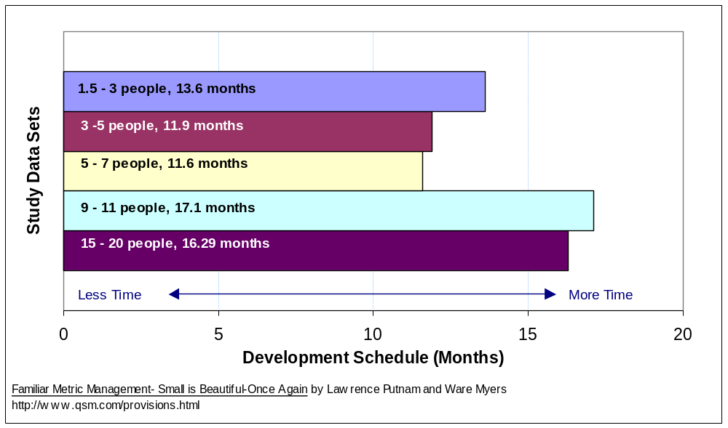
Average Schedule Months
Notes:
Purpose: To show the time scheduled for large teams is larger that for small team doing the same job, and that we know this by the historical data.
Key Points:
Some schedule (effectiveness) improvement as the small team grows.
Big negative jump at 8 team members
Average size for each set is 57K ESLOC, with each set being within 3K ESLOC of average
Transition: “Let’s see how productively (efficiently) they executed.”
Cross Reference to Auxiliary Material: Familiar Metric Management- Small is Beautiful-Once Again by Lawrence Putnam and Ware Myers. http://www.qsm.com/provisions.html

Slide 65
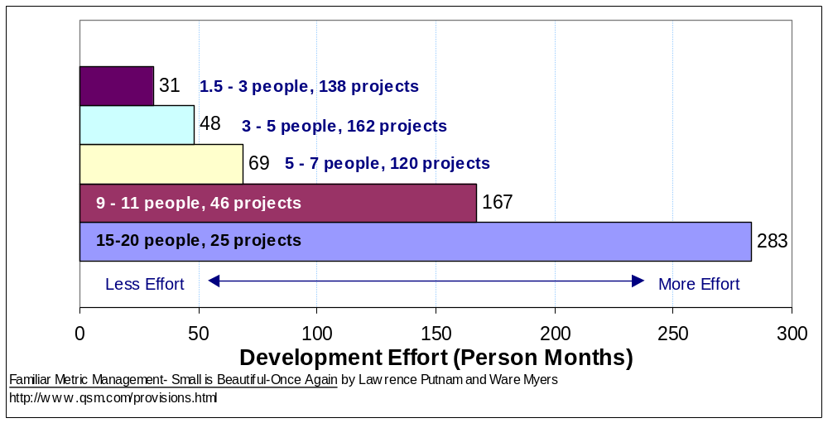
Development Effort
Notes:
Purpose: To show how much more effective a small team can be.
Key Points:
Data came from 491 projects.
Again the difference is most dramatic at 8 team members.
Figures are person months.
Small Teams are BOTH more EFFICIENT and more EFFECTIVE.
Transition: “Let’s look at how activities can be SEQUENCED.”
Cross Reference to Auxiliary Material: Familiar Metric Management- Small is Beautiful-Once Again by Lawrence Putnam and Ware Myers. http://www.qsm.com/provisions.html

Slide 66
Activity Sequencing
Test
Design
Construct
How would these normally be sequenced?
Notes:
Purpose: To give an elementary example of how to sequence activities.
Key Points:
Normally, Design comes before Construction which comes before testing.
Transition: “Gantt charts are often used to facilitate planning.”
Cross Reference to Auxiliary Material:

Slide 67
Using Gantt Charts
GANTT Charts
  A simple finish to start approach
    Sufficient?
    Effective?
    Efficient?
Design
F
S
Code
F
S
Test
Notes:
Purpose: To explain the use of Gantt charts.
Key Points:
This allows a Project Manager to look at and manage task level dependencies in a project.
The simple finish to start approach
Doesn’t account for feedback to correct errors or gain clarification.
Ensures the longest schedule.
May be most efficient.
Is common in ‘silo’ organizations or where there are ‘functional chimneys.’
Transition: “Let’s look at a more detailed task list for the same activities.”
Cross Reference to Auxiliary Material:

Slide 68
Using GANTT Charts
Single Resource Dependency
1
Preliminary Module Design
2
Review Design
3
Complete Module Design
4
Preliminary Test Plan
5
Preliminary Code Development
6
Code Review
7
Complete Code Development
8
Run Initial Tests
  Too Complex?
  Efficient?
  Effective?
Make Design Corrections
(Task Dependencies)
9A
F8-2
10A
Make Code Corrections
F8-1, F9A
11A
Continue Testing
F8, F9B, F10A
9B
Make More Design Corrections
F8-1
10B
Make More Code Corrections
F8, F9B
11B
Continue Testing
F9B, F10B
9C
Make Final Design Corrections
F8
10C
Make Final Code Corrections
F9C
11C
Complete Module Testing
F10C
1
5
10
15
20
25
30
35
Notes:
Purpose: To show how detail can allow more clarity.
Key Points:
The detail allows for feedback and correction.
The finish to start scheduling gives a 33 week schedule.
This finish to start scheduling is simple, but probably not effective.
Transition: “Assigning three people to these tasks allows considerable overlap.”
Cross Reference to Auxiliary Material:

Slide 69
Using GANTT Charts
Typical dependencies with three people: Analyst (A), Programmer (P), and Tester (T)
1
Preliminary Module Design; A
2
Review Design; A, P, T (Each at 50%)
3
Complete Module Design; A (50%) for first 2 time periods)
4
Preliminary Test Plan; T (50% for first 2 time periods)
5
Preliminary Code Development; P (50% for first 2 time periods)
6
Code Review; A (100%), P (50%), T (50%)
7
Complete Code Development; P
8
Run Initial Tests; T (50%)
9
Correct Design; A
10
Correct Code; P
11
Complete Module Testing; T
2
4
6
8
10
12
14
Notes:
Purpose: To illustrate the overlap possible using 3 people.
Key Points:
For Task 2 each individual also does skill specific work.
Note that the Project Plan is an instantiation of a Standard Development Process.
This dramatically shortens the schedule.
Transition: “Let’s take a look at a staffing histogram for this Gantt chart.”
Cross Reference to Auxiliary Material:

Slide 70
Typical Staffing Histogram
  Too Complex?
  Efficient?
  Effective?
Task 4
Task 8
T
Task 11
Task 2
Task 6
Task 5
Task 7
P
Task 10
Task 2
Task 6
Task 3
A
Task 1
Task 6
Task 9
What is the
Critical Path?
Task 2
1
2
3
4
5
6
7
8
9
10
11
12
13
14
Notes:
Purpose: To illustrate a staffing histogram.
Key Points:
A typical mistake is to have one person do it all; three is better for both speed and skills.
Since all tasks are bound both at the start and finish, they are ALL (because of resource constraints) on the critical path.
Transition: “Let’s try to identify a Critical Path in an easier example.”
Cross Reference to Auxiliary Material:

Slide 71
Critical Path Identification
What’s the Critical Path? (Assume the length of the box estimates the duration and that both Part A and Part B are needed to complete the project.)
Design Part A
Construct Part A
Test Part A
Design Part B
Construct Part B
Test Part B
Notes:
Purpose: To illustrate a staffing histogram.
Key Points:
This is meant to be an easily identified Critical Path.
Ask “Is the Critical Path clear to everyone?”
Give additional examples if this is unclear.
4. Note that Project Management is not using Microsoft Project^{tm}
Transition: “An important concept in Project Time Management is trading efficiency for effectiveness. Let’s look at how Project Time Management can affect schedule and cost.”
Cross Reference to Auxiliary Material:

Slide 72
Trading Efficiency for Effectiveness
Which is better? Why?
One person testing efficiently and taking 6 weeks and 6 staff weeks
  Three people testing less efficiently and taking 3 weeks and 9 staff weeks
Test 1 - 2 Weeks
Test 2 - 2 Weeks
Test 3 - 2 Weeks
Test 1 - 3 Weeks
Test 2 - 3 Weeks
TIP: Adding testers to a project (even late, even up to a 50% increase in staff) can improve schedules at a cost.
Test 3 - 3 Weeks
Notes:
Purpose: To illustrate trading efficiency for effectiveness and how it affects schedule and cost.
Key Points:
The value of the schedule saving must be weighed against the cost. Normally, functional managers balk at ‘cost wasting;’ they’re measured on cost.
If tasks are on the critical path, there may be substantial savings.
Transition: “Now let’s look, in more detail, at how a Project Manager handles Critical Path Management.”
Cross Reference to Auxiliary Material:

Slide 73
Critical Path Management
Critical path, the set of tasks where a schedule slippage in any one of them will cause the completion date to slip
TIP: Know the value of a day, week, and month in cost terms and opportunity terms
TIP: Track critical path metrics separately
TIP: Spend extra attention on risk management on the critical path
Notes:
Purpose: To discuss Critical Path Management.
Key Points:
A project manager should normally spend at least 80% of the time managing the critical path. Why? (note: Much of this time is spent managing COMMUNICATION activities.)
Identify risks separately for items on the Critical Path
People – especially burnout
Processes – meetings/status reporting/training
Quality – e.g., complexity and defects for software modules on the Critical Path.
Transition: “Let’s look at some actions a Project Manager might take to affect the Critical Path.”
Cross Reference to Auxiliary Material:

Slide 74
Critical Path Management
Long Term Critical Path Actions
1. Good Communications Plan
2. Initiate Cross Training
3. Apply Good Change Mgmt to Control Scope Creep
4. Keep Team Leaders off Critical Path
5. Increase Staff; Especially in Q.A.
6. Identify Resource Constraints
7. Risk Management
8. Schedule Vacations So They’re Not on the Critical Path
9. Back up Staff on the Critical Path
10. Accelerate Early - Start Critical Path Tasks Early (Overlap)
Continued…
Notes:
Purpose: To discuss long term Critical Path actions.
Key Points:
By taking these actions early and proactively, a project manager can minimize schedule slips.
Email/phone/internet, etc. Be careful to limit interruptions, if possible. It adds to non-value added activity.
It’s important to be effective as opposed to being efficient.
The critical path should only involve about 10-20% of the total effort of a project.
Transition: “Let’s look at some additional long term critical path actions.”
Cross Reference to Auxiliary Material:

Slide 75
Critical Path Management
Long Term Critical Path Actions
11. Don’t Train on the Critical Path
12. Add Staff With Flexibility to Help on the Critical Path
13. Analyze Resource Matrix - Histogram
14. Follow Good Processes
15. Take Actions to Control Stability of Requirements
16. Test Early
17. Plan Early and Frequent User Involvement
18. When in Doubt, Ask Your Manager
Notes:
Purpose: To continue discussing long term critical path actions.
Key Points:
11 People tend not to do this for some reason
14. Never abandon these
13. Make people aware of costs
16. It’s cheaper to find and fix problems early; take time to emphasize this point; reference STQE (Stickyminds) paper
5. 18. Because it’s on the CP it’s CRITTICAL
Transition: “Other important critical path actions are considered near term.”
Cross Reference to Auxiliary Material: STQE Paper on
“The cost of finding and fixing problems.”

Slide 76
Critical Path Management
Near Term Critical Path Actions
1. Track Critical Path Activities Daily (at Least)
2. Isolate Critical Path Associates From Interruptions
3. Focus Critical Path Associates on the Critical Path Activities
  Communicate Daily
  Ensure They Understand the Priority
4. Use two-three Hours of Overtime Daily If Necessary
5. Recognize Critical Path Associates
6. Defer Non-Critical Path Activities
7. Add Staff to Support Critical Path Associates (As a Surgical Team
Supports a Doctor - The Mythical Man Month, Frederick P. Brooks, Jr.)
8. Ensure Critical Path Associates Have Sufficient Equipment
9. Make Tools Available (Even Cell Phones, Beepers, and Rental Cars)
10. Excuse Critical Path Associates From Some Meetings
Notes:
Purpose: To discuss Near Term critical path actions.
Key Points:
The most important is to track daily.
Look for information yourself – keep your finger on the pulse.
Transition: “Now that we know something about Project Time Management, let’s look at how to build a good Work Breakdown Structure.”
Cross Reference to Auxiliary Material:

Slide 77
Work Breakdown Structure Based on Project Deliverables
Step 1: Identify all deliverables
Step 2: Identify all intermediate (intra/inter-process) artifacts
Step 3: Build a WBS based on the deliverables and artifacts
Step 4: Do a risk assessment
Step 5: Add “Risk Identification and Risk Abatement” pieces to the project WBS
Step 6: Add “Quality” pieces to the project WBS
Step 7: Add Project Specific Activities
Notes:
Purpose: To enable the student to define a WBS based on project deliverables and artifacts.
Key Points:
Risk and quality tasks are often forgotten when doing a WBS.
Having a quality professional work on the WBS is often useful.
A deliverables is something that is transferred to and an Artifact is something that is left behind.
A Deliverable is of use, and artifact was of use and could be again.
Transition: “Let’s define WBS Dictionary.”
Cross Reference to Auxiliary Material:

Slide 78
WBS Dictionary
Record essential information for actual completion of the work package and include:
  Description of the work
  List of Deliverable(s) (or artifact(s))
  Size of the deliverable(s)
  Effort (estimates as they become available)
  Required skill sets
  Related task information
  Predecessors and successors
  Completion and acceptance criteria
Notes:
Purpose: To enable the students to identify the Purpose of a WBS dictionary. To enable the students to understand the information necessary to create a complete WBS.
Key Points:
This information is very useful in planning and controlling a project.
Some of the information is difficult to get early in the project.
Transition: “Now, let’s look at an example of a WBS .”
Cross Reference to Auxiliary Material:

Slide 79
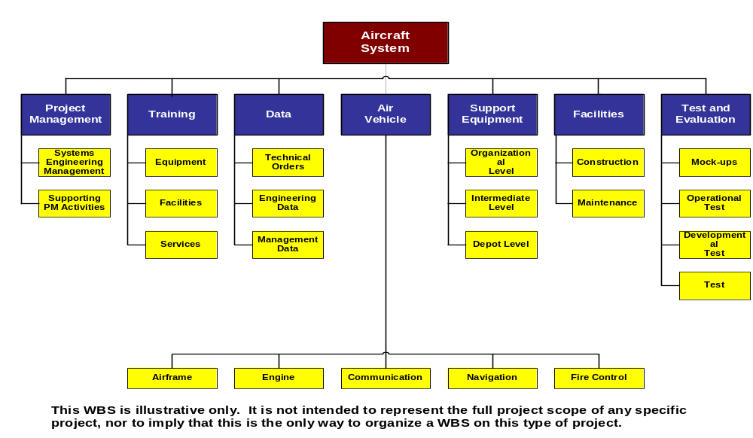
Sample Work Breakdown Structure for Defense Material Items
Notes:
Purpose: To show a sample WBS.
Key Points:
The form of a WBS could be a SOP Template.
This WBS is organized around, functions, deliverables and artifacts.
Transition: “Let’s look at another WBS style.”
Cross Reference to Auxiliary Material:

Slide 80
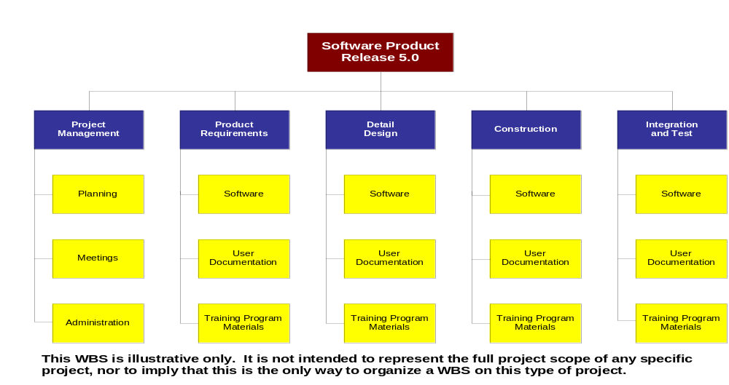
Sample Work Breakdown Structure Organized by Phase
Notes:
Purpose: To show a WBS with a different organization.
Key Points:
This is organized by phase (very common).
Transition: “Now, let’s look at the Network Diagram.”
Cross Reference to Auxiliary Material:

Slide 81
Network Diagram
Composed of Lowest Level Tasks from WBS
Two Methods:
  AOA (Activity on Arrow)
  AON (Activity on Node)
Has a Start and an End
Network Constructed with Predecessor and Successor Tasks forming Paths
Critical Path is any Path where there is a delay will delay the completion of the project
Notes:
Purpose: To enable students to understand the network diagram as a scheduling tool.
Key Points:
This information is very useful in producing a project schedule from the WBS.
Network diagrams can easily be done with post-it notes or using a software package such as MS Project.
Transition: “Let’s look at some examples.”
Cross Reference to Auxiliary Material:

Slide 82
Network Diagram Examples
AOA (Activity on Arrow)
AON (Activity on Node)
T1
T2
T3
T4
T5
T7
T6
T1
T2
T3
Start
T4
Finish
T5
T6
T7
Notes:
Purpose: To show examples of the two types of network diagrams.
Key Points:
Activity on arrow isn’t used very much.
The Activity on Node diagram lends itself to using post-it notes
We will be using the activity on node in the case study exercise.
(It is also used in MS Project)
Transition: “Let’s look at how to find the critical path.”
Cross Reference to Auxiliary Material:

Slide 83
Critical Path
Where is the Critical Path?
Where would it be if Task 6 took 6 days?
3d
4d
5d
T1
T2
T3
4d
Start
Finish
4d
2d
4d
T4
T5
T6
T7
Notes:
Purpose: To show how to find the critical path.
Key Points:
The critical path is any path through the network diagram that when delayed also delays the completion of the project.
Critical paths can change as tasks slip (take longer than planned or get started late).
Can have multiple critical paths (this adds more risk to your project).
Transition: “Let’s look at some common elements in an Integrated Project Plan.”
Cross Reference to Auxiliary Material:

Slide 84
Project Plan Outline
Management Summary
Project Charter
Project Requirements
Project Deliverables
Risk Assessment and
Mitigation Strategies
Resources and
Responsibilities
Schedule
Reporting
Standards
Warranty(ies)
Support
Post-Project Evaluations
Supporting Plans
  (e.g., Quality Plans)
Other Relevant Documents and Files
Notes:
Purpose: To define an outline of a project plan.
Key Points:
These are fairly standard sections for a Project Plan.
Ask “What are some other sections you might find in one of your company’s project plan?”
Ask “For what you do, are all of these sections really necessary?”
Transition: “Let’s work on the ACME Case Study.”
Cross Reference to Auxiliary Material:

Slide 85
Case Study – You Are Here
Introduction to ACME Case Study
Getting Started Exercise
Project Initiation and Risk Exercise
Project Planning Exercise
  Work Breakdown Structure
  Network Diagram and Critical Path
Project Execution Exercise
Project Control Exercise
Notes:
Purpose: Allow students to see where they are relative to all Case Study exercises
Key Points:
Ask “Why are we doing a Work Breakdown Structure exercise?”
Ask “Why are we doing a Network Diagram and Critical Path exercise?”
Transition: “Lets get started reading the material and answering the questions in the exercise… instructors will be available to offer help.”
See Case Study Instructor Notes for Further Details
Cross Reference to Auxiliary Material: ACME Case Study

Slide 86
The ACME Case Study
Break into groups of four
Review the ACME Case Study materials (pages 22, 23 and 24)
Create a Work Breakdown Structure (page 25)
Think high level first
Notes:
Purpose: To reinforce the learning of the module, especially about Project Time Management.
Key Points:
These is a fairly long exercise, allow 1 to 1 and a half hours to do WBS and CP.
Divide into the same groups and build on your previous work.
The facilitator will review your work separately.
Transition: “When finished, we’ll look at the Project Manager’s role in Project Execution.”
Cross Reference to Auxiliary Material:

Slide 87
The ACME Case Study
Stay in groups of four
Create a Network Diagram
  Fill out the predecessors/successors template (page 26)
  Create a network diagram
Identify the Critical Path (page 28)
Notes:
Purpose: To reinforce the learning of the module, especially about Project Time Management.
Key Points:
Build on your previous work.
The facilitator will review your work separately.
Transition: “When finished, we’ll look at the Project Manager’s role in Project Execution.”

Slide 88
The Transition into Project Management
Project Execution

Slide 89
You Are Here
Course Introduction
The Accidental Profession
Project Initiation
Project Planning
Project Execution
Project Control
Project Closeout
Course Conclusion
Notes:
Purpose: To give the students a view of where they’ve been in the course, where they are in the course and where they’re going in the course.
Key Points:
Ask “Are there any questions concerning anything we’ve already coverer?”
Although project execution takes the majority of the staff resources, if the project was initiated and planned well, execution can be fun.
Transition: “Let’s look at the objectives of the Project Execution module.”
Cross Reference to Auxiliary Material:

Slide 90
Module Objectives
Allow participants to:
  Understand Human Resources Management
  Describe the role of the Project Manager with respect to project execution
Notes:
Purpose: To set student expectations.
Key Points:
This is a small module, but does include 2 important key knowledge areas.
Ask “How important is Human Resources Management?”
Transition: “Okay, let’s take a look at the Project Human Resource Management Key Knowledge Area.
Cross Reference to Auxiliary Material:

Slide 91
Key Knowledge Area –
Human Resource Management
What is Project Human Resource Management?
  Ensuring the most effective use of the people involved with the project
  Includes all stakeholders, e.g., sponsors, customers, individual contributors
  Being effective even with the temporary nature of projects
  Being effective even where personal and organizational relationships are transient
Notes:
Purpose: To introduce the students to the Key Knowledge Area of Project Human Resource Management.
Key Points:
Ask “What exactly is a stakeholder again?”
Projects are temporary, so motivation is a key element to success.
Transition: “Let’s look at the processes in Project Human Resource Management.”
Cross Reference to Auxiliary Material:

Slide 92
Processes in Project Human Resource Management
Organizational Planning – identifying, documenting and assigning project roles, responsibilities and reporting relationships
Staff Acquisition – getting the human resources needed assigned to and working on the project
Team Development – developing individual and group skills to enhance project performance
Notes:
Purpose: To introduce the students to the 3 processes described in the PMBOK for Project Human Resource Management.
Key Points:
Because communications overhead can ruin a project, clear roles and responsibilities are critical.
Ask “Do you ever have trouble getting the staff you need?” Ask “Are you at all responsible for it?”
Ask “How do you develop a motivated and directed team?”
Transition: “Let’s jump into the role of a Project Manager during Project Execution.”
Cross Reference to Auxiliary Material:

Slide 93
Project Manager’s Role During Project Execution
Ensure that the project management processes are appropriately efficient and effective
Optionally: Ensure that the product and/or service development processes are also appropriately efficient and effective
Notes:
Purpose: To describe the role of a project manager during project execution.
Key Points:
The project manager may or may not contribute as an individual contributor towards the development of the targeted product or service. In small teams, the technical team leader is often also the ‘project manager.’
Ask “What happens if the project manager also has some functional work to do?” “When is this appropriate?”
Transition: “Let’s play a little game of ‘Win All That You Can.’”
Cross Reference to Auxiliary Material:

Slide 94
Case Study – You Are Here
Introduction to ACME Case Study
Getting Started Exercise
Project Initiation and Risk Exercise
Project Planning Exercise
Project Execution Exercise
  Win All That You Can
Project Control Exercise
Notes:
Purpose: Allow students to see where they are relative to all Case Study exercises
Key Points:
Let’s have some fun playing a game.
We’ll talk about what we learn later.
See Case Study Instructor Notes for Further Details
Cross Reference to Auxiliary Material: ACME Case Study

Slide 95
The ACME Case Study
Break into groups of four
Play “Win All That You Can” (page 31)
Notes:
Purpose: To reinforce the need to get people acting as a team with a common Purpose.
Key Points:
Give each team of four a red and a green card.
Appoint a team leader.
Don’t allow collaboration between teams.
Keep score on a white board/flip chart.
Transition: “Now that we know how important it is to get people acting for a common Purpose, let’s move on to the Project Control module.”
Cross Reference to Auxiliary Material:

Slide 96
The Transition into Project Management
Project Control

Slide 97
You Are Here
Course Introduction
The Accidental Profession
Project Initiation
Project Planning
Project Execution
Project Control
Project Closeout
Course Conclusion
Notes:
Purpose: To give the students a view of where they’ve been in the course, where they are in the course and where they’re going in the course.
Key Points:
Ask “Are there any questions about what we’ve covered so far.”
This can be a difficult subject since “CONTROL” has many negative connotations.
Transition: “Let’s look at the module objectives.”
Cross Reference to Auxiliary Material:

Slide 98
Module Objectives
Allow participants to:
  Given a situation, compute work remaining
  Detect schedule slippage
  Identify overloaded resources
  Describe typical scope control techniques
  Manage change effectively
    Describe different types of change
    Explain how to respond to different types of change
    Explain tradeoffs associated with change responses
    Understand typical changes encountered on IT projects
Notes:
Purpose: To set student expectations.
Key Points:
Control can be done in many ways, but good metrics are critical.
Change is the curse of many projects.
Transition: “Let’s look at one definition of Control.”
Cross Reference to Auxiliary Material:

Slide 99
Project Control
“Control is achieved by comparing where one is with where one is supposed to be, then taking corrective action to resolve any discrepancies that exist.”
(J.P. Lewis)
Notes:
Purpose:
To introduce the concept of project control.
Key Points:
This is just a quote (amongst many) that defines project control.
Ask “How do you control your projects?”
Transition:
“Next, let’s look at some issues of measurement.”
Cross Reference to Auxiliary Material:
Lewis, J.P.

Slide 100
Why Measure?
To change and monitor behavior
As a foundation for process improvements
  Shorten development cycles
  Improve quality
  Reduce costs and risks
Monitor progress against project baseline
Forecast project progress
To ensure timely corrective actions
To help estimate future projects
REARVIEW  IN PROCESS  PREDICTIVE
Notes:
Purpose:
To introduce the Purpose of measuring in project management.
Key Points:
Good measurement is the key to controlling the project.
To know the truth: “The truth is out there!”
Good metrics facilitate good communications.
Predictive measures are best. Give an example.
Transition: “What are some of the problems that arise out of the use of control of metrics techniques?”
Cross Reference to Auxiliary Material:

Slide 101
Requirements Change per Month
Requirements Change per Month
  The number of changes to the original agreed upon requirements
  The financial impact of the accepted changes as a percentage of the originally estimated costs
Goal:
  To understand the magnitude of the impact from changing requirements
  To allow early corrective actions (for example, for unnecessary scope creep)
Notes:
Purpose: To discuss the impact of requirements change per month on a project.
Key Points:
Requirements changes, especially late in the project, cause significant thrashing and cause projects to be completed late.
These same techniques can be used to manage other changes.
Transition: “Let’s take a look at the use of Discovery Rate of Defects in a project.”
Cross Reference to Auxiliary Material:

Slide 102
Discovery Rates
Actual Discovered
#’s
Today
Planned Defects
Time
Notes:
Purpose: To illustrate how discovery rates compare to planned rates in a project.
Key Points:
What happens if the actual defects found are less than the planned defects found? The schedule is longer.
What happens if the total actual defects are more than planned? Both schedule and cost are adversely impacted.
Transition: “The next slide shows cumulative discovery and repair rates.”
Cross Reference to Auxiliary Material:

Slide 103
Cumulative Discover and Repair Rates
Planned
Discovered
Predicted Cumulative Defects
Planned
Repaired
Actual Discovered
Actual Repaired
Notes:
Purpose: To illustrate cumulative discovery and repair rates.
Key Points:
What will happen? It will take much longer than planned to find problems.
It will take much, much longer than planned to fix problems.
Transition: “Let’s go back to the ACME Case Study and look at what’s going on as the project progresses.”
Cross Reference to Auxiliary Material:

Slide 104
Case Study – You Are Here
Introduction to ACME Case Study
Getting Started Exercise
Project Initiation and Risk Exercise
Project Planning Exercise
Project Execution Exercise
Project Control Exercise
  Managing the Project
Notes:
Purpose: Allow students to see where they are relative to all Case Study exercises
Key Points:
Problem Solving and Teamwork
This is the last exercise.
Transition: “Lets get started reading the material and coming up with some solutions for the exercise… instructors will be available to offer help.”
See Case Study Instructor Notes for Further Details
Cross Reference to Auxiliary Material: ACME Case Study

Slide 105
The ACME Case Study
Break into groups of four
Replan the project based on the bad news (page 32)
Notes:
Purpose: To ensure that the students can perform identify reasonable options for “replanning”.
Key Points:
Break into the same groups.
Use the worksheets and data provided.
Have your work checked by the facilitator.
Ask “Is ‘bad news’ common or uncommon in a project? Emphasize that this type of news is common, but must be communicated quickly.
Complete the exercise in 20 minutes.
Transition: “After this exercise we’ll move on to the PROJECT CLOSEOUT module.”
Cross Reference to Auxiliary Material:

Slide 106
The Transition into Project Management
Project Closeout

Slide 107
You Are Here
Course Introduction
The Accidental Profession
Project Initiation
Project Planning
Project Execution
Project Control
Project Closeout
Course Conclusion
Notes:
Purpose: To give the students a view of where they’ve been in the course, where they are in the course and where they’re going in the course.
Key Points:
Ask “Are there any questions over anything we’ve covered so far.”
This is a fun section because if you’ve made it this far, you’ve probably succeeded and it’s time to capture the information, to reward people and to help others.
Transition: “Let’s look at the module objectives.”
Cross Reference to Auxiliary Material:

Slide 108
Module Objectives
Allow participants to:
  Describe approaches to gathering, maintaining and applying Project Lessons Learned
  Explain typical requirements for transition to support and operations
  List some ways to celebrate and acknowledge the team
Notes:
Purpose: To set student expectations.
Key Points:
Capturing lessons learned is important for all projects if improvements are going to be made.
Poor transitions can cause unnecessary problems.
A good party is almost always in order.
Transition: “Let’s talk about the process of Project Closeout.”
Cross Reference to Auxiliary Material:

Slide 109
The Process of Project Closeout
The Project Closeout Process ensures that:
The project sponsor, client, or customer accepts the project as concluded
The various completed project records, final revisions, and issued documents reflect the achieved project goals
Essential project documents are kept and maintained for future reference
Notes:
Purpose: To identify the Purpose of the Project Closeout Process.
Key Points:
If the goal of the project was to satisfy the stakeholders, then getting final acceptance is the only proof that the goal was met.
Be careful in keeping necessary and useful documents.
Transition: “Why is effective project closeout so important?”
Cross Reference to Auxiliary Material:

Slide 110
Importance of Effective Project Closeout
Effective Project Closeout procedures ensure that
Project is completed in a timely manner
Warranties and operation begin as scheduled
Customers receive all project-related information
Materials and supplies are disposed of properly
Final reports are prepared
Lessons Learned are documented
Project Artifacts are archived
Notes:
Purpose: To discuss the importance of effective project closeout.
Key Points:
This dramatically improves a project managers ability to plan future projects.
Capturing lessons learned leads to sustainable improvements.
Transition: “There are some risks that we must assess.”
Cross Reference to Auxiliary Material:

Slide 111
Closeout Activities
Perform Final Risk Assessment in the following three areas:
    Stakeholders Satisfaction
    Achievement of Goals
    Cost, schedule, and performance
Determine lessons learned
Capture and analyze all metrics
Notes:
Purpose: To identify the three areas in which to perform final risk assessment.
Key Points:
Again, this helps in future projects.
Try to understand the root causes of variations to plan.
Transition: “What Lessons Learned should we capture?”
Cross Reference to Auxiliary Material:

Slide 112
Recording Lessons Learned
The following must be evaluated when recording lessons learned:
Organizational structure of the team
Processes and procedures
Tools
Training
Time, cost, and resources
Conflict management
Communication plan
Notes:
Purpose: To identify the factors that should be involved when recording lessons learned.
Key Points:
Frequently a post-project, full team debriefing is helpful.
A final presentation to senior management is often useful.
Transition: “It is important that you closely follow the guidelines for the project closeout phase.”
Cross Reference to Auxiliary Material:

Slide 113
Guidelines for the Project Closeout Phase
Observe the following guidelines during the Project Closeout Phase:
Acknowledge the project closeout phase formally on the project schedule
Develop a closeout plan that includes all vital details
Hold status meetings periodically until all project activities are complete
Conduct remote site visits if the project team locations are not physically connected
Continued…
Notes:
Purpose: To introduce the guidelines for the project closeout phase.
Key Points:
The closeout costs time and money and should be planned.
Be especially careful to have some staff during closeout.
Transition: “Let’s take a look at the rest of the guidelines for the project closeout phase.”
Cross Reference to Auxiliary Material:

Slide 114
Guidelines for the Project Closeout Phase (continued)
Observe the following guidelines during the Project Closeout Phase:
Provide team members with meaningful rewards
Give feedback on performance of all team members to functional managers
Schedule a formal closeout review
Identify and record lessons learned to improve the performance of future projects
Create an official project closeout document to record the lessons learned and communicate them to others
Notes:
Purpose: To introduce the remaining guidelines for the project closeout phase.
Key Points:
Take the time to provide formal feedback to team members.
Create a formal project closeout report.
Transition: “Let’s look at how all of the processes that we’ve discussed relate to one another.”
Cross Reference to Auxiliary Material:

Slide 115
Project Life Cycle
Typical Process Overlap*
Executing
Processes
Level
Planning
of
Processes
Initiating
Closing
Activity
Processes
Processes
Controlling
Processes
Start
Finish
Time
*PMBOK 2000
Notes:
Purpose: To show the students that the 5 major process overlap in time and have different levels of activity.
Key Points:
Note that processes overlap over time. There is not a fixed end to one process that then starts another.
Normally, the level of effort is highest for the executing processes. This is when the majority of the staff effort is expended.
Transition: “Let’s think about everything we’ve learned.”
Cross Reference to Auxiliary Material: PMBOK 2000

Slide 116
What have you learned?
What is one important thing that you think you can take away from the course?
Are there any questions about any of the course materials?
Notes:
Purpose: To reinforce the learning for the students..
Key Points:
Encourage people to say WHY something was important.
Take as much time as is necessary..
Transition: “We’ll move on to the last module and the final exam.”
Cross Reference to Auxiliary Material:

Slide 117
The Transition into Project Management
Course Conclusion

Slide 118
You Are Here
Course Introduction
The Accidental Profession
Project Initiation
Project Planning
Project Execution
Project Control
Project Closeout
Course Conclusion
Notes:
Purpose: To give the students a view of where they’ve been in the course and where they are in the course.
Key Points:
Ask “Are there any questions about what we’ve covered so far?
Ask “Are there any questions about the final exam?”
There are 25 multiple choice questions on the exam.
Transition: “Then, let’s look at the module objectives.”
Cross Reference to Auxiliary Material:

Slide 119
Module Objectives
Allow participants to:
  Ask any final questions
  Demonstrate an appropriate level of knowledge
  Get feedback to improve the class
Notes:
Purpose: To set student expectations.
Key Points:
If you have any questions that you would rather have answered privately, call or email a facilitator.
The final exam is geared to help students better remember what they’ve learned.
Transition: “Let’s move on to the wrap-up.”
Cross Reference to Auxiliary Material:

Slide 120
Wrap Up
Instructor Feedback
Review Attainment of Learning Objectives
Course Evaluation
Final Exam
Notes:
Purpose: To close the class.
Key Points:
Pass out instructor feedback forms.
Review the learning objectives of the class (Slide 3).
Transition: “THANK YOU.”
Cross Reference to Auxiliary Material:

Slide 121
Course Objectives (Wrap-up)
Allow participants to:
  Understand the fundamental principles of project management
  Understand the benefits of good people
  Understand the processes used in project management
  Understand the basic tools for managing small projects
  Be able to summarize senior management’s role in project selection, sponsorship, and direction
  Be able to explain when to ask for help on projects
  This course is not intended to make anyone a project management expert.
Notes:
Purpose: Review and highlight the course objectives.
Key Points:
Ask about degree of attainment of each objective.
Ask for any other questions.
Pass out the Course Evaluation.
Pass out and score the Final Exam.
Transition: “Okay, time for the final exam.”
Cross Reference to Auxiliary Material:

